Slide 1
Best Selling Books Trends From 2009 To 2019
By Sujal Ponnaluri

Slide 2
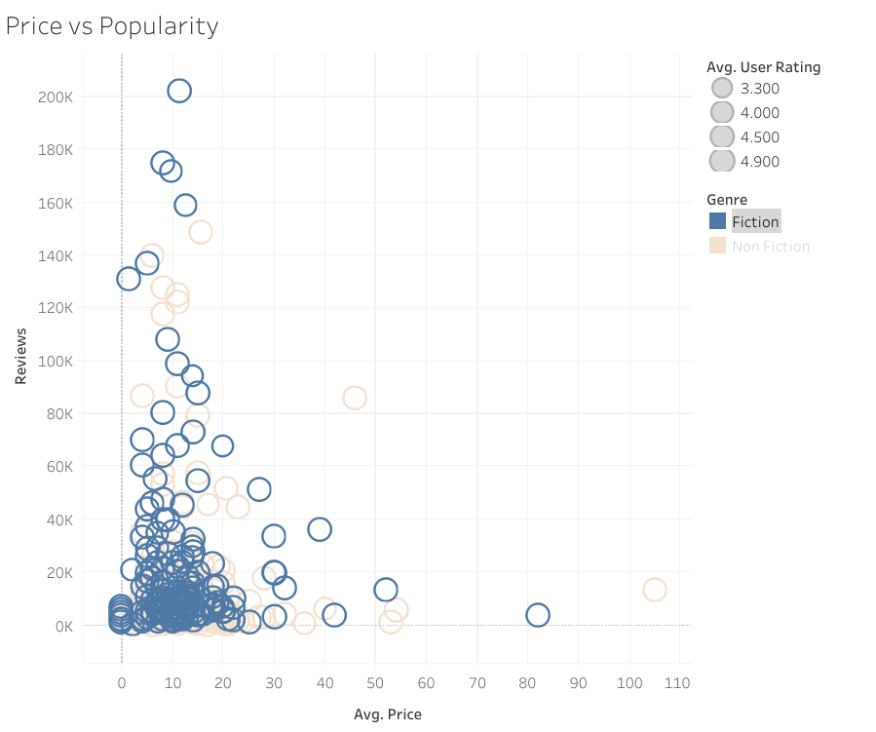
Book price does not appear to strongly determine popularity. Several lower-priced books received a very high number of reviews, suggesting that affordability may encourage more purchases and reader engagement. Additionally, highly reviewed books appear across both Fiction and Non-Fiction genres, indicating strong reader interest in a wide range of book categories rather than a single dominant genre.

Slide 3
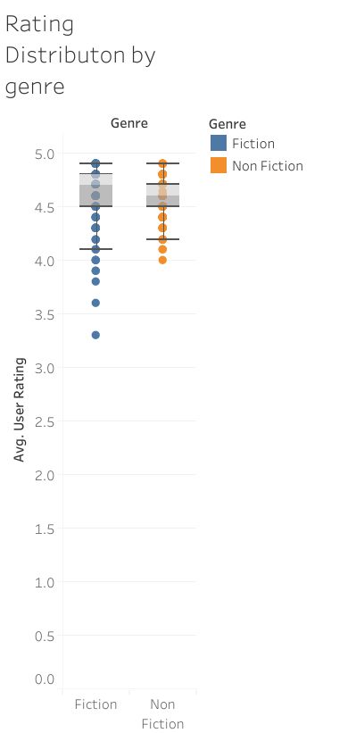
The box plot compares the distribution of user ratings between Fiction and Non-Fiction best-selling books. The results show that both genres maintain consistently high ratings, with most books falling between 4.5 and 4.9. Fiction books show slightly more variation in ratings, while Non-Fiction ratings tend to be more tightly clustered. Overall, the visualization suggests that bestselling books across both genres generally receive strong positive feedback from readers.

Slide 4
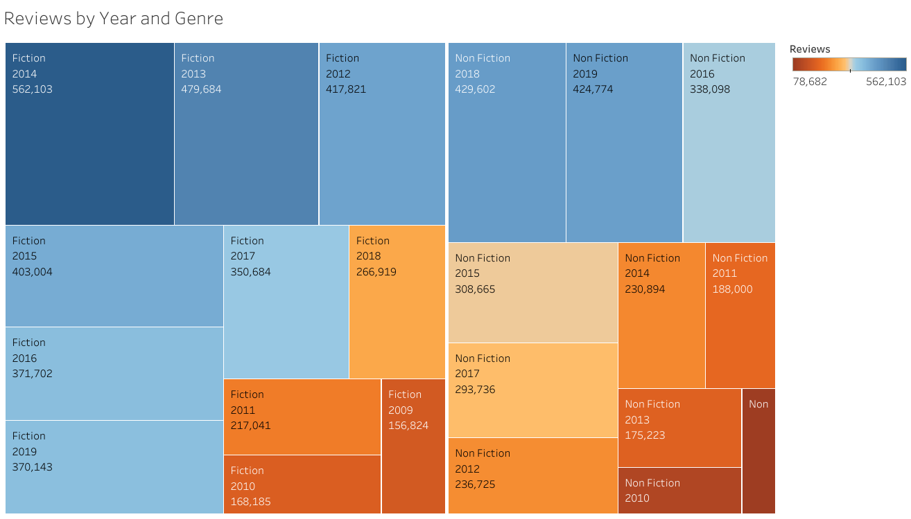
Review generally increases in the later years, showing that readers are more active in sharing feedback and posting reviews online. Some years also show noticeable spikes in the number of reviews, which indicate the release of particularly popular titles during those periods. Both Fiction and Non-Fiction books consistently receive strong reader attention across multiple years, showing steady interest in best-selling books across genres.

Slide 5
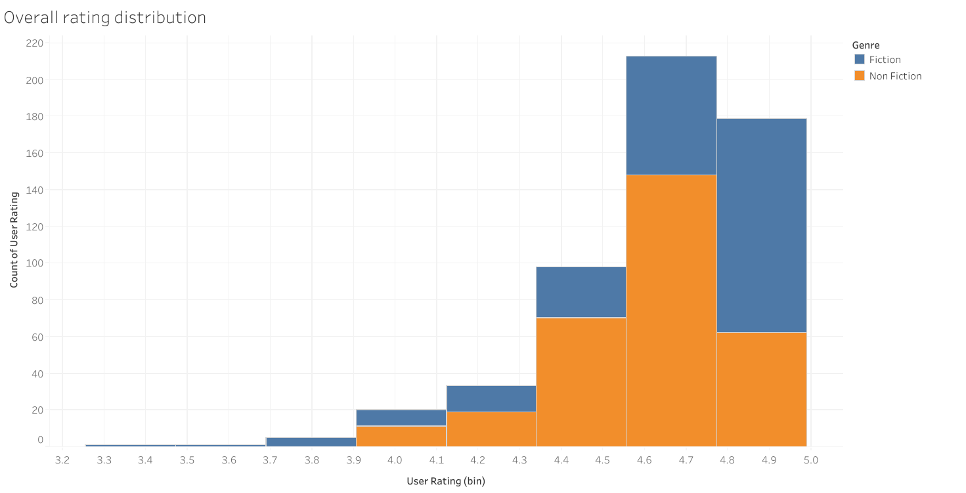
The ratings are concentrated with a narrow range near the higher end of the scale, with the largest number of books appearing in the bins between roughly 4.6 and 4.8. Both Fiction and Non-Fiction books appear frequently within this range, showing that highly rated titles exist across both genres. Only a small number of books appear in the lower rating bins, while the higher rating bins contain the majority of observations. This pattern shows that ratings for best-selling books tend to cluster closely together, indicating consistent and strong reader evaluations across many titles.

